Slide 1

SkillSwap Connect: Empowering Peer-to-Peer Learning
A Major Project for a Web Development Internship – VOC by Leslie Fernando.
Date: 07 September 2025

Slide 2
Introduction: Unlocking Learning Potential
SkillSwap Connect is an innovative peer-to-peer learning platform designed to connect individuals who want to teach what they know with those eager to learn what they love. It's built on the principle of community-driven, accessible, and engaging learning.
1
2
List Skills
Smart Matching
Users easily list skills they can teach and skills they wish to learn, creating a dynamic profile of their knowledge exchange interests.
Our intelligent algorithm connects complementary learners and teachers, ensuring meaningful and productive skill exchanges.
3
4
Seamless Sessions
Tech Stack
Facilitate scheduling of learning sessions, share appreciation, and award badges to acknowledge progress and contributions.
Developed with React (styled-components, framer-motion) for a fluid frontend and a Node/Express API for robust backend operations.

Slide 3
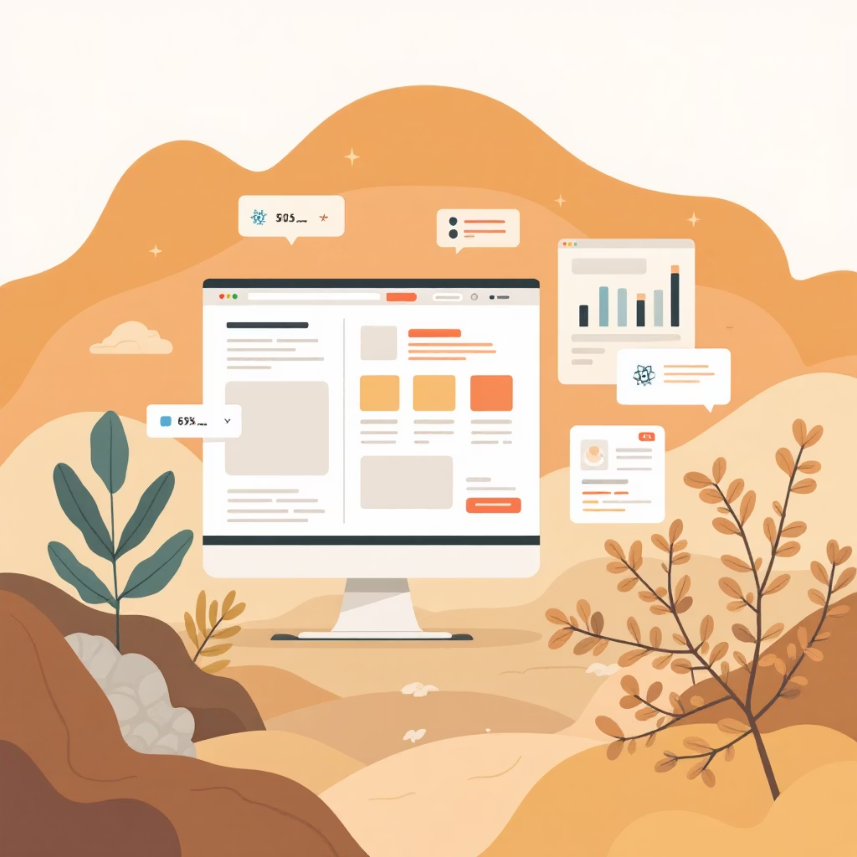

Architectural Foundations
Frontend: Responsive and Dynamic
Backend: Robust and Scalable (Initial)
The user interface is a React Single Page Application (SPA), engineered for responsiveness across all devices. It incorporates modern design elements like:
Our backend is built on Node.js and Express.js, providing a flexible and efficient RESTful API. For this initial demo, data is stored in-memory, allowing for rapid development and demonstration of core functionalities.
Animated, interactive cards for skill displays.
Subtle toast notifications for real-time feedback.
Handles user skill profiles.
Fluid animations (powered by Framer Motion) to enhance user experience.
Manages session proposals and confirmations.
Processes "Wall of Thanks" messages and badge awards.

Slide 4




User Journey: From Sign-Up to Skill-Up
Onboarding & Profile Setup
Match Discovery
Users sign in and intuitively set their "teach" and "learn" skills, crafting a comprehensive profile of their expertise and interests.
The platform presents intelligently matched connections based on complementary skills, facilitating seamless discovery of potential teachers or learners.
Session Coordination
Recognition & Community
Propose sessions specifying the skill and preferred time. Both parties can then accept or confirm, formalizing the learning commitment.
Post "Wall of Thanks" messages to express gratitude and award badges for successful exchanges, contributing to a dynamic leaderboard and fostering a positive community.

Slide 5
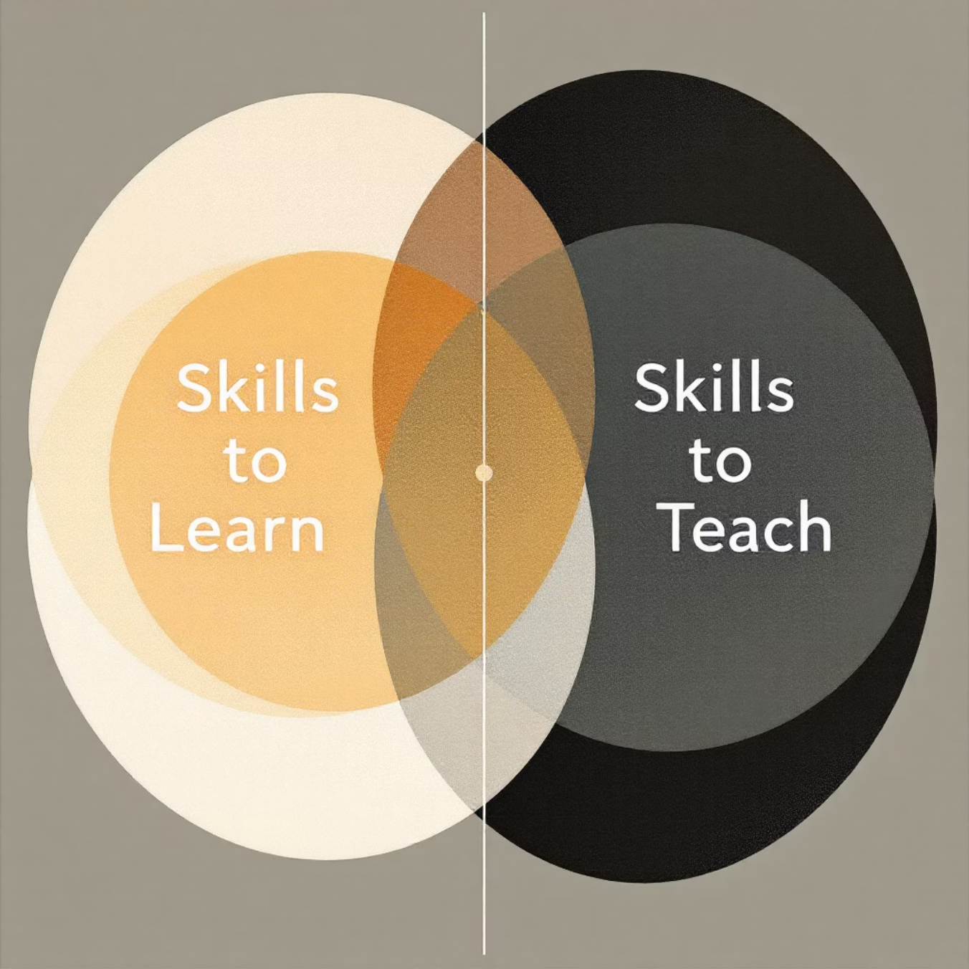
The Magic Behind Matching
SkillSwap Connect's core innovation lies in its intuitive matching system. It's designed to bring together users whose learning needs align perfectly with others' teaching abilities.
Our algorithm performs a bidirectional intersection:
Your "Skills to Learn" are matched with other users' "Skills to Teach".
Your "Skills to Teach" are matched with other users' "Skills to Learn".
This ensures every match offers a reciprocal learning opportunity, maximising engagement and benefit for both participants.
"The platform's matching is surprisingly accurate, connecting me with exactly the skills I needed to learn!"
— Early User Feedback

Slide 6






Enhancing User Experience
We've meticulously crafted the user experience with several key features to ensure an engaging, accessible, and enjoyable platform.
Proactive Suggestions
Timely Notifications
Intelligent prompts guide users through the platform, suggesting next steps or relevant connections.
Subtle, non-intrusive toasts provide real-time feedback on actions and updates.
Gamified Engagement
Delightful Interactions
Awarding badges and a dynamic leaderboard encourage participation and friendly competition.
Fun animations, like confetti for achievements, add moments of joy to the user journey.
Adaptive Interface
Inclusive Design
A user-selectable dark mode caters to personal preferences and reduces eye strain.
Built with accessibility standards in mind, ensuring the platform is usable by all individuals.

Slide 7





Versatile Applications
SkillSwap Connect isn't just a platform; it's a flexible tool with diverse applications across various sectors, democratising access to knowledge.
Campus Education
Corporate Mentorship
Community Learning
Ideal for peer tutoring, study clubs, and inter-departmental skill sharing within universities.
Facilitates internal mentorship programmes and cross-team skill exchanges in professional environments.
Empowers community centres and non-profit organisations to offer inclusive and accessible learning opportunities.
Event-Based Learning
Personal Development
Perfect for rapid knowledge sharing at hackathons, meetups, and conferences, fostering dynamic learning environments.
Offers individuals a platform to practice teaching, build professional portfolios, and expand their personal network.

Slide 8


Advantages & Considerations
Key Advantages
Current Limitations & Future Considerations
Democratised Learning: Provides low-cost or free access to diverse skills.
In-Memory Storage: Demo version uses temporary data, requiring persistence for production.
Rapid Onboarding: Simple, mobile-first UI ensures quick user adoption.
High Engagement: "Thanks" messages, badges, and leaderboards boost interaction.
Trust & Quality: Future iterations need ratings, reviews, and verification for reliability.
Accessibility & Extensibility: Designed to be inclusive, responsive, and easy to expand upon.
Scheduling Challenges: Coordinating availability can be tricky and requires robust tools.
Scalability & Security: Requires authentication hardening and content moderation for large-scale deployment.

Slide 9





Future Scope: Expanding Horizons
Our vision for SkillSwap Connect extends far beyond its current capabilities. We plan to introduce several enhancements to solidify its position as a leading peer-to-peer learning platform.
Reliability & Scale
Implementing robust databases, advanced authentication (AuthN), Role-Based Access Control (RBAC), rate limits, and comprehensive monitoring for production readiness.
Trust & Safety
Developing verification processes, detailed ratings/reviews, reputation systems, and moderation tools to foster a secure and reliable environment.
Enhanced Scheduling & Communication
Integrating calendar synchronisation, automated reminders, real-time notifications, and in-app video call capabilities for seamless interactions.
Intelligent Learning
Leveraging AI for smarter matching, personalised skill path recommendations, and adaptive learning experiences.
Growth & Monetisation
Introducing features like learning groups/cohorts, organised events/challenges, and exploring monetisation or sponsorship models.

Slide 10
Key Takeaways & Next Steps
SkillSwap Connect is more than just an application; it's a testament to the power of community-driven learning, designed to empower individuals through accessible knowledge exchange.
Key Takeaways
Next Steps
Innovation: A novel approach to peer learning, leveraging modern web technologies.
Pilot Programme: Implement a beta test within a university campus or corporate environment.
User-Centric Design: Focus on intuitive UX, engagement, and accessibility.
User Feedback: Gather insights to refine features and address pain points.
Scalable Vision: Clear roadmap for future development and expanded functionality.
Backend Transition: Migrate from in-memory to persistent data storage (e.g., PostgreSQL or MongoDB).
Real-World Impact: Potential to revolutionise informal learning in various settings.
Security Audit: Conduct a thorough review to enhance platform security and user privacy.

